Slide 1

CSCE 5218
Deep Learning
Convolutional Neural Networks
Slides adapted from Adriana Kovashka

Slide 2
Plan for this lecture
Motivation: Scanning for patterns
Convolutional network operations
Common architectures
Visualizing convolutional networks
Applications in computer vision

Slide 3
Plan for this lecture
Motivation: Scanning for patterns
Convolutional network operations
Common architectures
Visualizing convolutional networks
Applications in computer vision

Slide 4
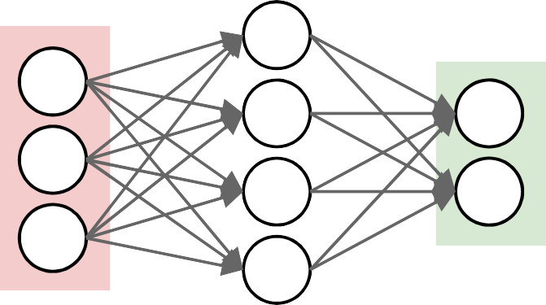

Neural networks so far
output layer
input layer
Can recognize patterns in data (e.g. digits)
Adapted from Bhiksha Raj

Slide 5
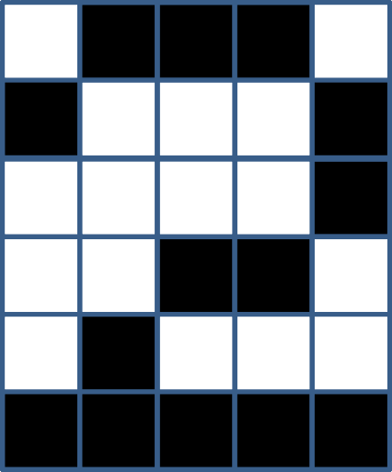
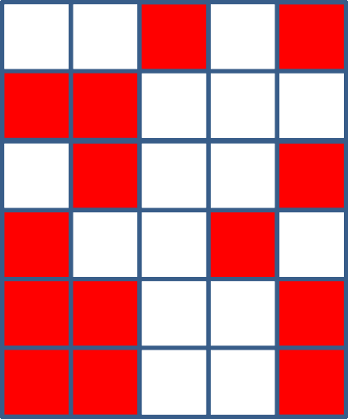
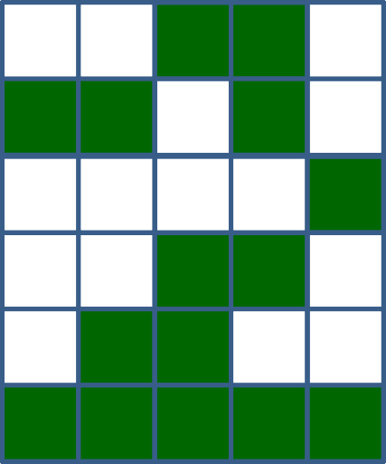

The weights look for patterns
Correlation = 0.57
Correlation = 0.82
1 𝑖𝑓 Σ𝑤_{i}x_{i} ≥ 𝑇
𝑦 = {
0 𝑒𝑙𝑠𝑒
The green pattern looks more like the weights pattern (black) than the red pattern
– The green pattern is more correlated with the weights
Bhiksha Raj

Slide 6
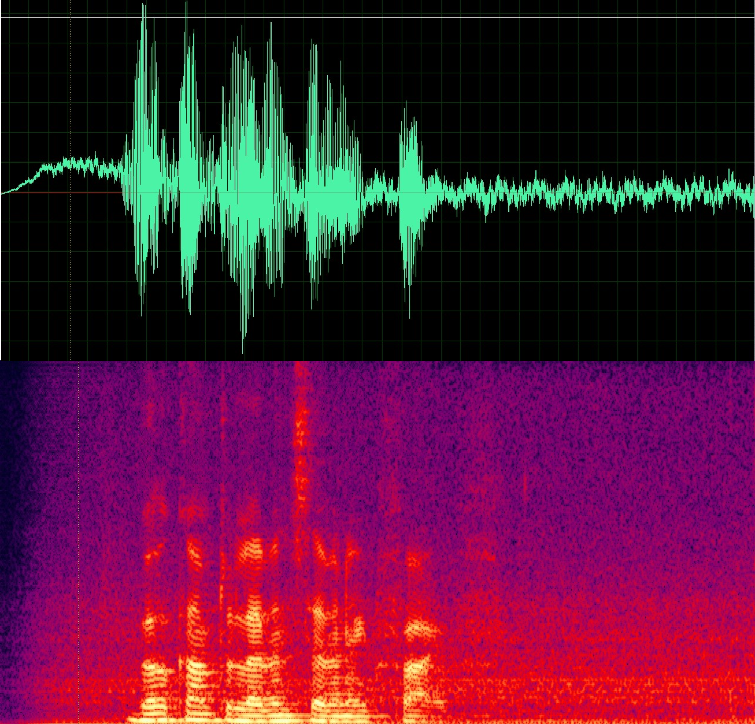
A problem
Does this signal contain the word “Welcome”?
Compose a NN for this problem
– Assuming all recordings are exactly the same length
Bhiksha Raj

Slide 7




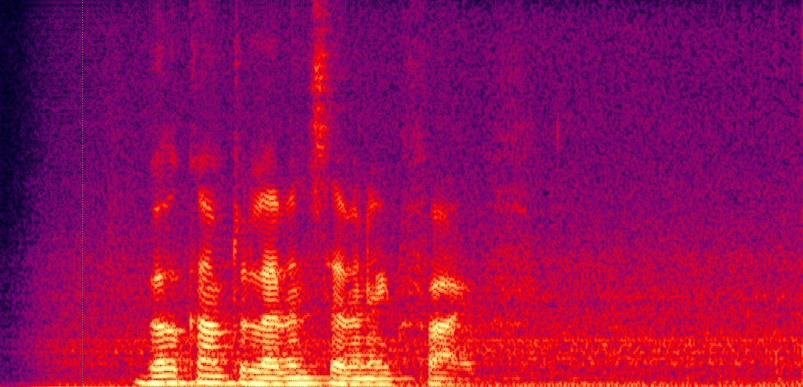
Finding a Welcome
Trivial solution: Train a NN for the entire recording
Bhiksha Raj

Slide 8
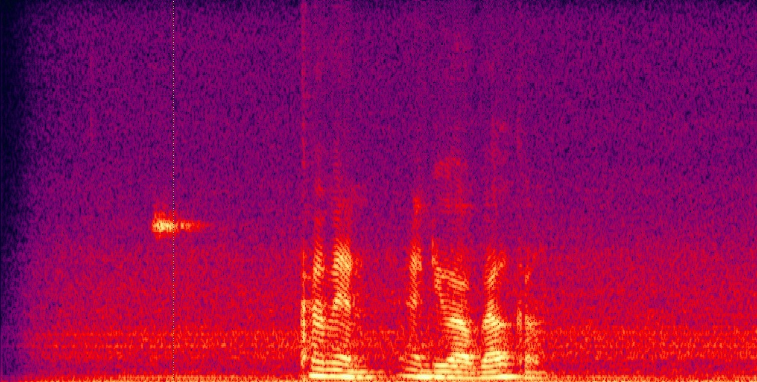
Finding a Welcome
Problem with trivial solution: Network that finds a “welcome” in the top recording will not find it in the lower one
Unless trained with both
Will require a very large network and a large amount of training data to cover every case
Bhiksha Raj

Slide 9
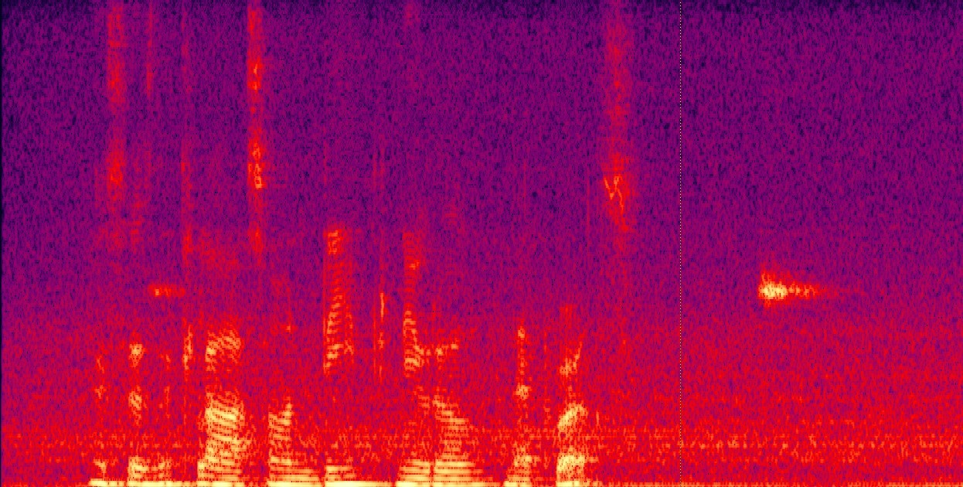
Finding a Welcome
Need a simple network that will fire regardless of the location of “Welcome”
– and not fire when there is none
Bhiksha Raj

Slide 10
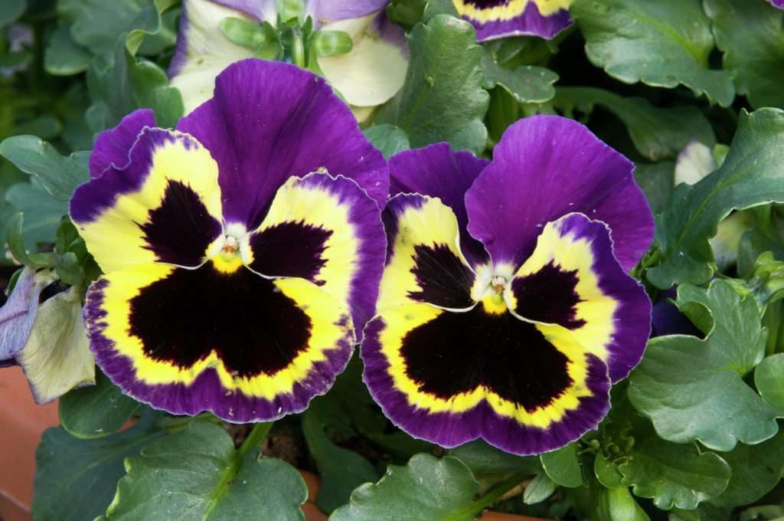



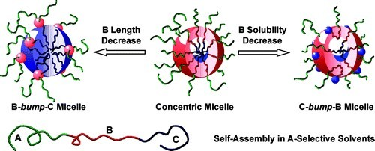


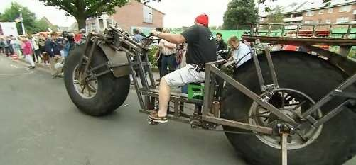

Flower
Is there a flower in any of these images?
Bhiksha Raj

Slide 11
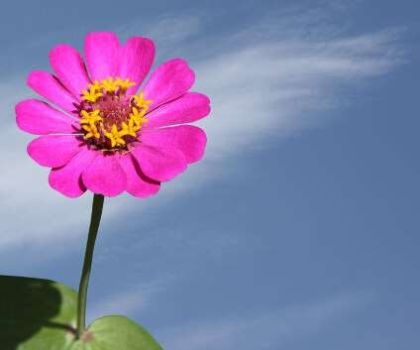
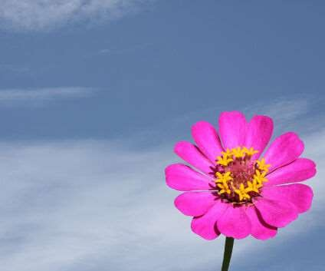
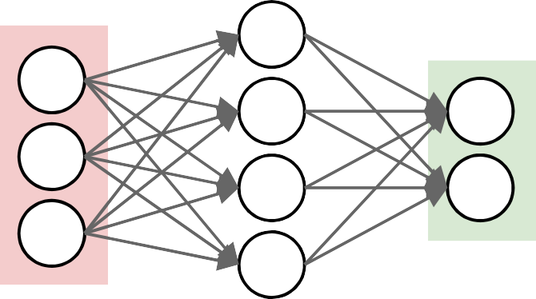
Flower
input layer
output layer
Will a NN that recognizes the left image as a flower also recognize the one on the right as a flower?
Need a network that will “fire” regardless of the precise location of the target object
Bhiksha Raj

Slide 12
The need for shift invariance
In many problems the location of a pattern is not important
Only the presence of the pattern is important
Conventional NNs are sensitive to location of pattern
Moving it by one component results in an entirely different input that the NN won't recognize
Requirement: Network must be shift invariant
Bhiksha Raj

Slide 13
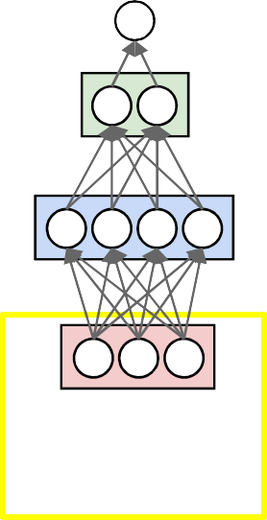
Solution: Scan
Scan for the target word
– The audio signals in a “window” are input to a “welcome-detector” NN
Adapted from Bhiksha Raj

Slide 14

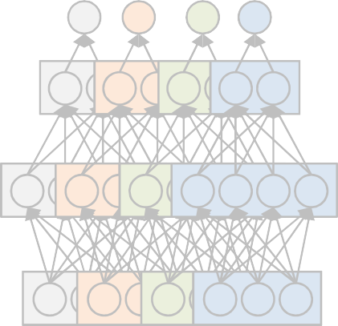
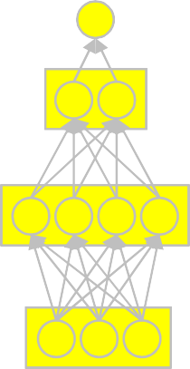
Solution: Scan
“Does welcome occur in this recording?”
Maximum of all outputs (Equivalent of Boolean OR)
Or more complex function
Adapted from Bhiksha Raj

Slide 15
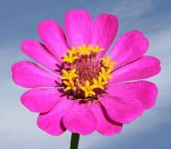
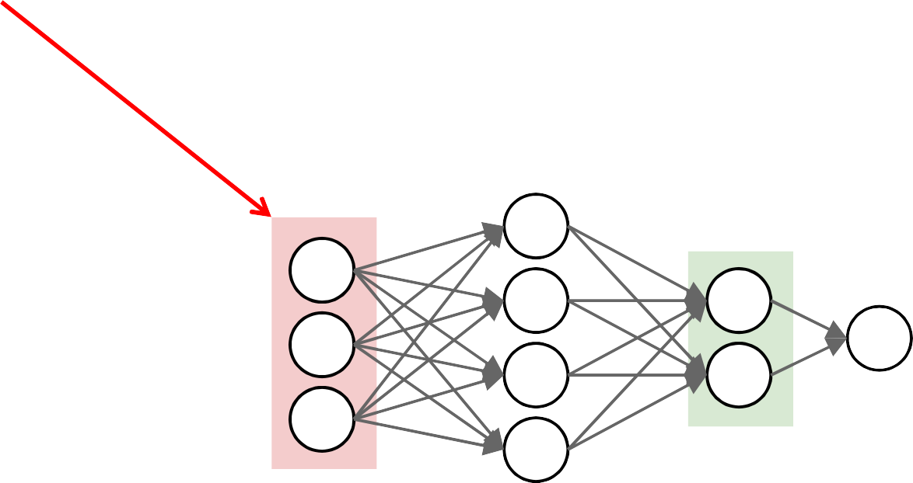
2-d analogue: Does this picture have a flower?
Scan for the desired object
“Look” for the target object at each position
At each location, entire region is sent through NN
Bhiksha Raj

Slide 16
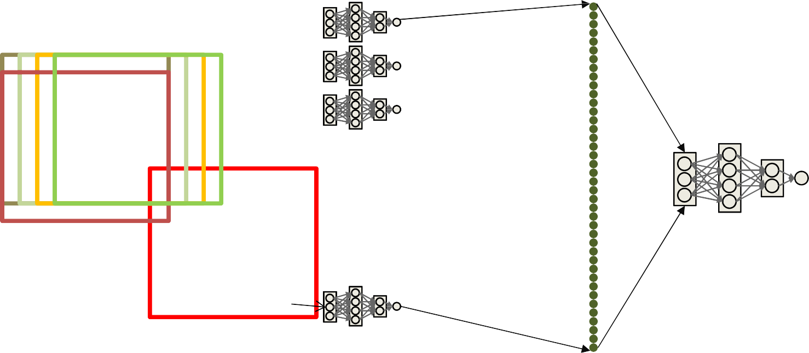
A giant net with common identical subnets
Determine if any of the locations had a flower
Each dot in the right represents the output of the NN when it classifies one location in the input figure
Look at the maximum value
Or pass it through a simple NN (e.g. linear combination + softmax)
Adapted from Bhiksha Raj

Slide 17
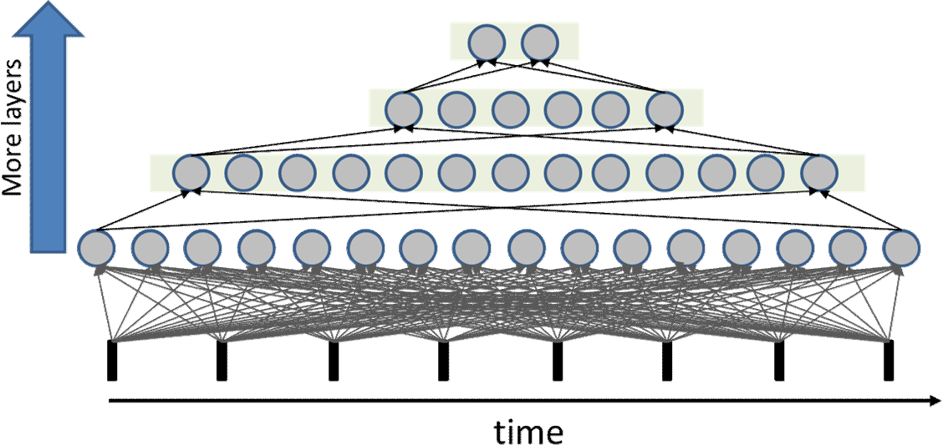


Regular network
11 | 12 | 13 | 14 | 1M
21 | 22 | 23 | 24 | 2M
31 | 32 | 33 | 34 | 3M
41 | 42 | 43 | 44 | 4M
(1)
(1)
N1
N2
N3
N4
NM
Consider the first layer
– Assume N inputs and M outputs
The weights matrix is a full N x M matrix
– Requiring N*M unique parameters
Bhiksha Raj

Slide 18
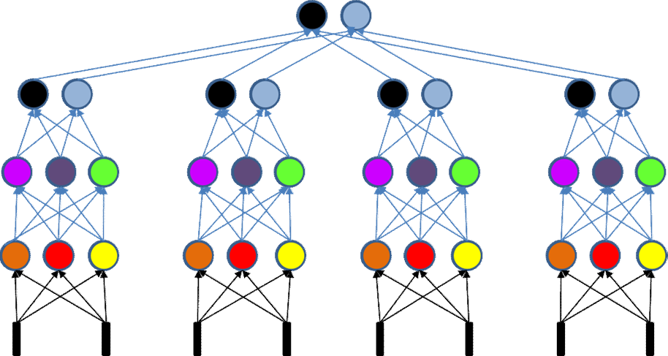

Scanning networks
(1)
11 12
time
21 22
31 32
(1)
11 12
21 22
31 32
11 12
31
32
In a scanning NN each neuron is connected to a subset of neurons in the previous layer
The weights matrix is sparse
The weights matrix is block structured with identical blocks
– The network is a shared parameter model
Adapted from Bhiksha Raj

Slide 19
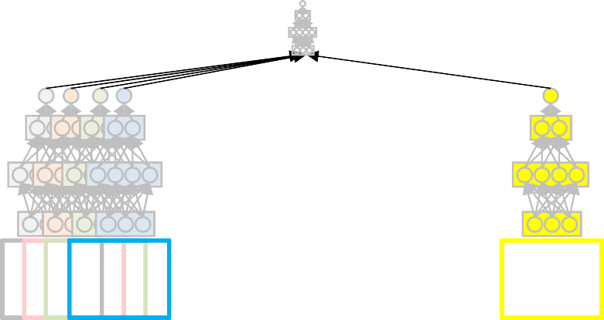
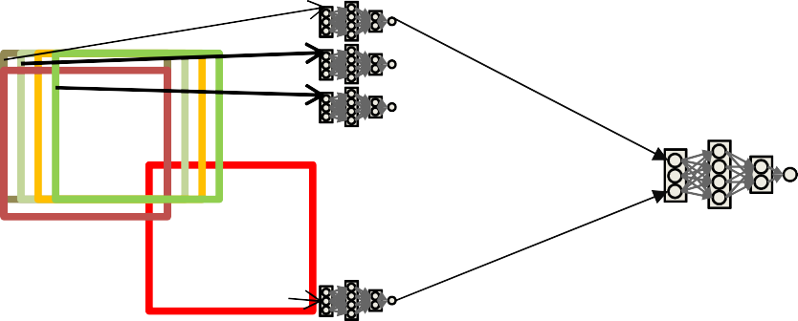


Training the network
These are really just large networks
Can use conventional backpropagation to learn parameters
Backprop learns a network that maps the training inputs to the target binary outputs
Bhiksha Raj

Slide 20
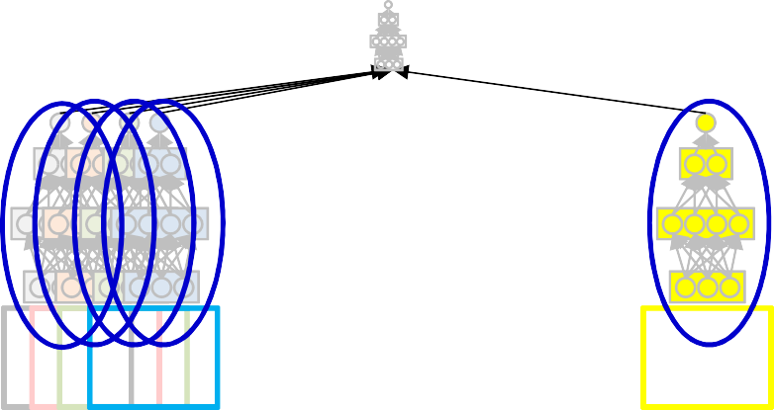
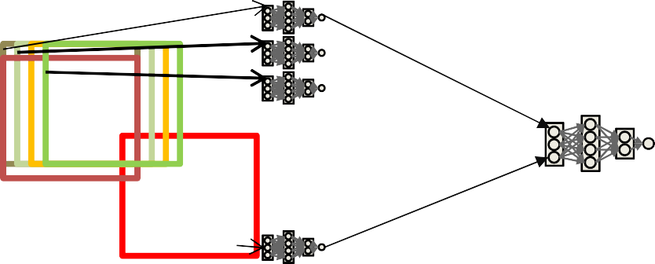
Training the network: constraint
These are shared parameter networks
All lower-level subnets are identical
Are all searching for the same pattern
Any update of the parameters of one copy of the subnet must equally update all copies
Bhiksha Raj

Slide 21
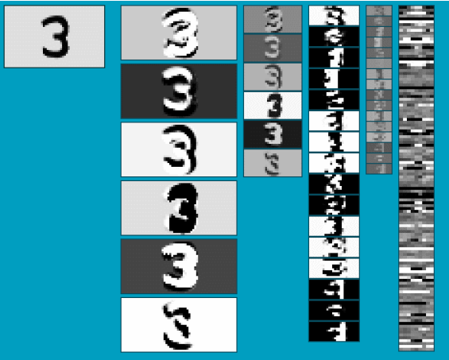
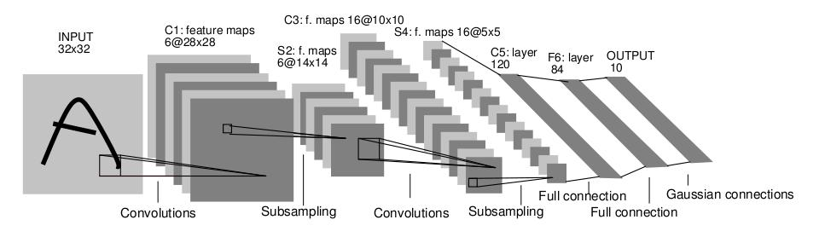
Convolutional Neural Networks (CNN)
Neural network with specialized connectivity structure
Stack multiple stages of feature extractors
Higher stages compute more global, more invariant, more abstract features
Classification layer at the end
Y. LeCun, L. Bottou, Y. Bengio, and P. Haffner, Gradient-based learning applied to document recognition, Proceedings of the IEEE 86(11): 2278–2324, 1998.
Adapted from Rob Fergus

Slide 22
Convolutional Neural Networks (CNN)
Feed-forward feature extraction:
Convolve input with learned filters
Apply non-linearity
Spatial pooling (downsample)
Recent architectures have additional operations (to be discussed)
Trained with some loss, backprop
Output (class probs)
…
Spatial pooling
Non-linearity
Convolution (Learned)
Input Image
Adapted from Lana Lazebnik

Slide 23
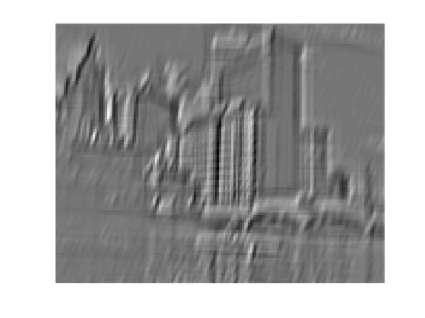
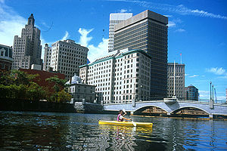
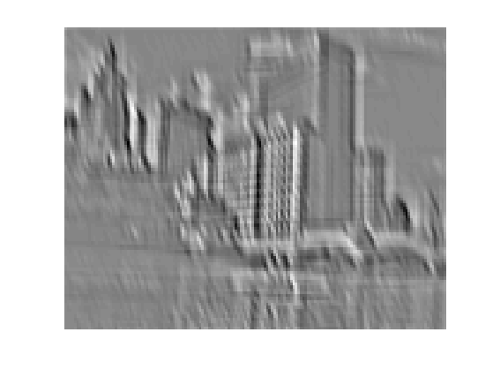
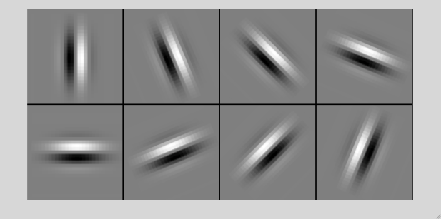
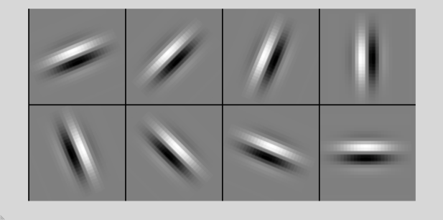
1. Convolution
Apply learned filter weights
One feature map per filter
Stride can be greater than 1 (faster, less memory)
...
Input
Feature Map
Adapted from Rob Fergus

Slide 24
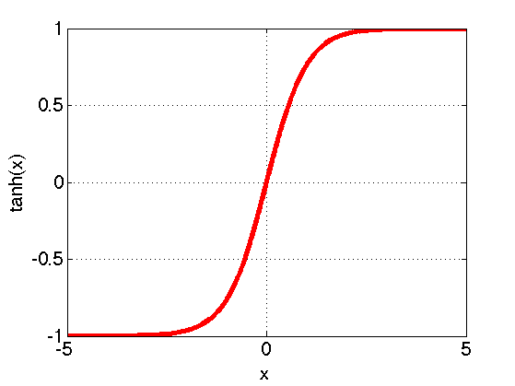
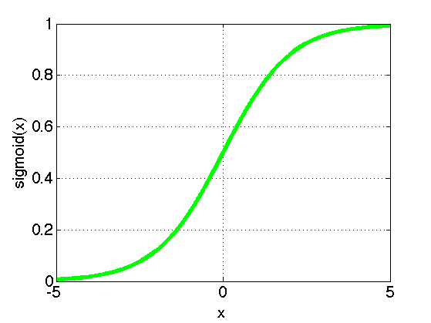
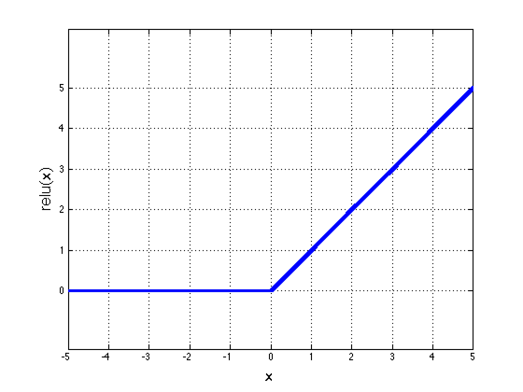
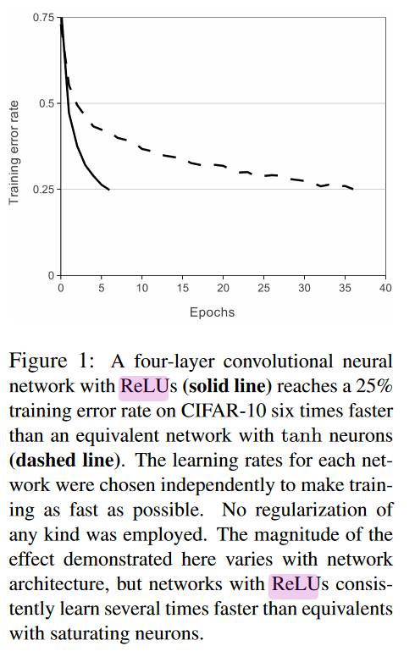
2. Non-Linearity
Per-element (independent)
Some options:
Tanh
Sigmoid: 1/(1+exp(-x))
Rectified linear unit (ReLU)
Avoids saturation issues
Krizhevsky et al.
Adapted from Rob Fergus

Slide 25


3. Spatial Pooling
Sum or max over non-overlapping / overlapping regions
Role of pooling:
Invariance to small transformations
Larger receptive fields (neurons see more of input)
Rob Fergus, figure from Andrej Karpathy

Slide 26
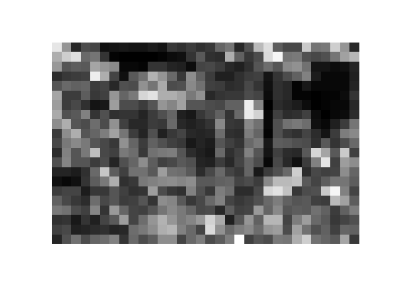
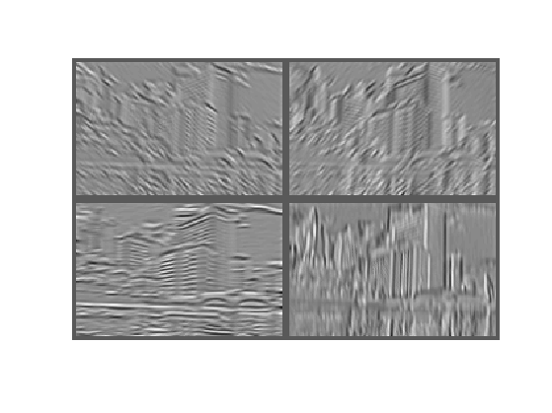
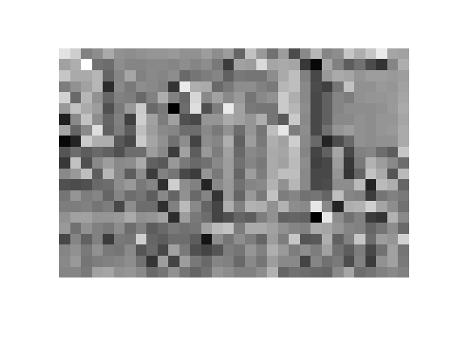
3. Spatial Pooling
Sum or max over non-overlapping / overlapping regions
Max
Sum
Adapted from Rob Fergus

Slide 27
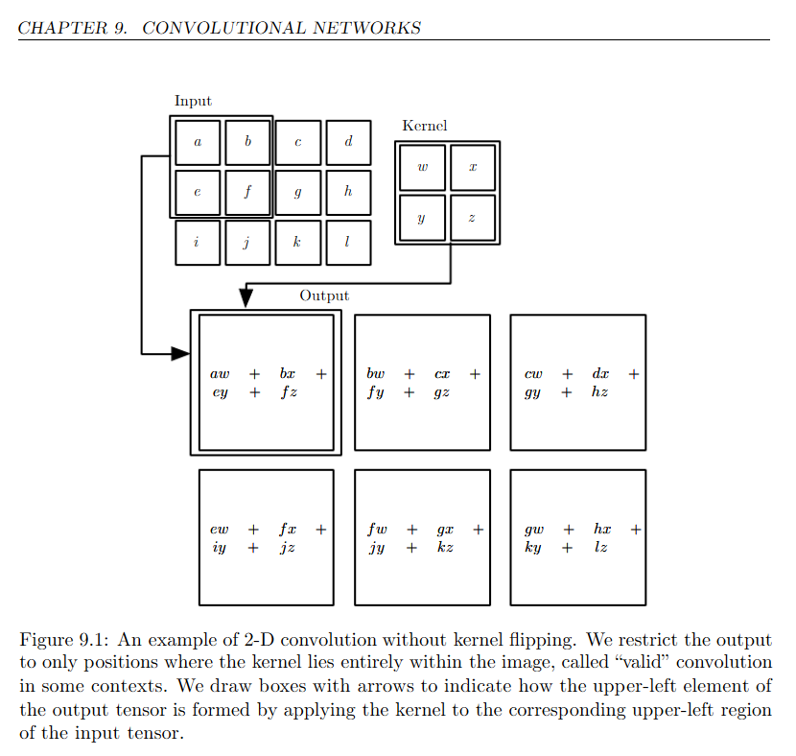
Goodfellow DL book

Slide 28
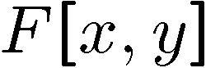
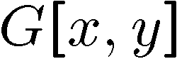
Background: Moving Average In 2D
0 | 0 | 0 | 0 | 0 | 0 | 0 | 0 | 0 | 0
0 | 0 | 0 | 0 | 0 | 0 | 0 | 0 | 0 | 0
0 | 0 | 0 | 90 | 90 | 90 | 90 | 90 | 0 | 0
0 | 0 | 0 | 90 | 90 | 90 | 90 | 90 | 0 | 0
0 | 0 | 0 | 90 | 90 | 90 | 90 | 90 | 0 | 0
0 | 0 | 0 | 90 | 0 | 90 | 90 | 90 | 0 | 0
0 | 0 | 0 | 90 | 90 | 90 | 90 | 90 | 0 | 0
0 | 0 | 0 | 0 | 0 | 0 | 0 | 0 | 0 | 0
0 | 0 | 90 | 0 | 0 | 0 | 0 | 0 | 0 | 0
0 | 0 | 0 | 0 | 0 | 0 | 0 | 0 | 0 | 0
 | 0
0 | 0 | 0 | 0 | 0 | 0 | 0 | 0 | 0 | 0
0 | 0 | 0 | 0 | 0 | 0 | 0 | 0 | 0 | 0
0 | 0 | 0 | 90 | 90 | 90 | 90 | 90 | 0 | 0
0 | 0 | 0 | 90 | 90 | 90 | 90 | 90 | 0 | 0
0 | 0 | 0 | 90 | 90 | 90 | 90 | 90 | 0 | 0
0 | 0 | 0 | 90 | 0 | 90 | 90 | 90 | 0 | 0
0 | 0 | 0 | 90 | 90 | 90 | 90 | 90 | 0 | 0
0 | 0 | 0 | 0 | 0 | 0 | 0 | 0 | 0 | 0
0 | 0 | 90 | 0 | 0 | 0 | 0 | 0 | 0 | 0
0 | 0 | 0 | 0 | 0 | 0 | 0 | 0 | 0 | 0
Source: S. Seitz

Slide 29
Background: Moving Average In 2D
0 | 0 | 0 | 0 | 0 | 0 | 0 | 0 | 0 | 0
0 | 0 | 0 | 0 | 0 | 0 | 0 | 0 | 0 | 0
0 | 0 | 0 | 90 | 90 | 90 | 90 | 90 | 0 | 0
0 | 0 | 0 | 90 | 90 | 90 | 90 | 90 | 0 | 0
0 | 0 | 0 | 90 | 90 | 90 | 90 | 90 | 0 | 0
0 | 0 | 0 | 90 | 0 | 90 | 90 | 90 | 0 | 0
0 | 0 | 0 | 90 | 90 | 90 | 90 | 90 | 0 | 0
0 | 0 | 0 | 0 | 0 | 0 | 0 | 0 | 0 | 0
0 | 0 | 90 | 0 | 0 | 0 | 0 | 0 | 0 | 0
0 | 0 | 0 | 0 | 0 | 0 | 0 | 0 | 0 | 0
 | 0 | 10
0 | 0 | 0 | 0 | 0 | 0 | 0 | 0 | 0 | 0
0 | 0 | 0 | 0 | 0 | 0 | 0 | 0 | 0 | 0
0 | 0 | 0 | 90 | 90 | 90 | 90 | 90 | 0 | 0
0 | 0 | 0 | 90 | 90 | 90 | 90 | 90 | 0 | 0
0 | 0 | 0 | 90 | 90 | 90 | 90 | 90 | 0 | 0
0 | 0 | 0 | 90 | 0 | 90 | 90 | 90 | 0 | 0
0 | 0 | 0 | 90 | 90 | 90 | 90 | 90 | 0 | 0
0 | 0 | 0 | 0 | 0 | 0 | 0 | 0 | 0 | 0
0 | 0 | 90 | 0 | 0 | 0 | 0 | 0 | 0 | 0
0 | 0 | 0 | 0 | 0 | 0 | 0 | 0 | 0 | 0
Source: S. Seitz

Slide 30
Background: Moving Average In 2D
0 | 0 | 0 | 0 | 0 | 0 | 0 | 0 | 0 | 0
0 | 0 | 0 | 0 | 0 | 0 | 0 | 0 | 0 | 0
0 | 0 | 0 | 90 | 90 | 90 | 90 | 90 | 0 | 0
0 | 0 | 0 | 90 | 90 | 90 | 90 | 90 | 0 | 0
0 | 0 | 0 | 90 | 90 | 90 | 90 | 90 | 0 | 0
0 | 0 | 0 | 90 | 0 | 90 | 90 | 90 | 0 | 0
0 | 0 | 0 | 90 | 90 | 90 | 90 | 90 | 0 | 0
0 | 0 | 0 | 0 | 0 | 0 | 0 | 0 | 0 | 0
0 | 0 | 90 | 0 | 0 | 0 | 0 | 0 | 0 | 0
0 | 0 | 0 | 0 | 0 | 0 | 0 | 0 | 0 | 0
 | 0 | 10 | 20
0 | 0 | 0 | 0 | 0 | 0 | 0 | 0 | 0 | 0
0 | 0 | 0 | 0 | 0 | 0 | 0 | 0 | 0 | 0
0 | 0 | 0 | 90 | 90 | 90 | 90 | 90 | 0 | 0
0 | 0 | 0 | 90 | 90 | 90 | 90 | 90 | 0 | 0
0 | 0 | 0 | 90 | 90 | 90 | 90 | 90 | 0 | 0
0 | 0 | 0 | 90 | 0 | 90 | 90 | 90 | 0 | 0
0 | 0 | 0 | 90 | 90 | 90 | 90 | 90 | 0 | 0
0 | 0 | 0 | 0 | 0 | 0 | 0 | 0 | 0 | 0
0 | 0 | 90 | 0 | 0 | 0 | 0 | 0 | 0 | 0
0 | 0 | 0 | 0 | 0 | 0 | 0 | 0 | 0 | 0
Source: S. Seitz

Slide 31
Background: Moving Average In 2D
0 | 0 | 0 | 0 | 0 | 0 | 0 | 0 | 0 | 0
0 | 0 | 0 | 0 | 0 | 0 | 0 | 0 | 0 | 0
0 | 0 | 0 | 90 | 90 | 90 | 90 | 90 | 0 | 0
0 | 0 | 0 | 90 | 90 | 90 | 90 | 90 | 0 | 0
0 | 0 | 0 | 90 | 90 | 90 | 90 | 90 | 0 | 0
0 | 0 | 0 | 90 | 0 | 90 | 90 | 90 | 0 | 0
0 | 0 | 0 | 90 | 90 | 90 | 90 | 90 | 0 | 0
0 | 0 | 0 | 0 | 0 | 0 | 0 | 0 | 0 | 0
0 | 0 | 90 | 0 | 0 | 0 | 0 | 0 | 0 | 0
0 | 0 | 0 | 0 | 0 | 0 | 0 | 0 | 0 | 0
 | 0 | 10 | 20 | 30
0 | 0 | 0 | 0 | 0 | 0 | 0 | 0 | 0 | 0
0 | 0 | 0 | 0 | 0 | 0 | 0 | 0 | 0 | 0
0 | 0 | 0 | 90 | 90 | 90 | 90 | 90 | 0 | 0
0 | 0 | 0 | 90 | 90 | 90 | 90 | 90 | 0 | 0
0 | 0 | 0 | 90 | 90 | 90 | 90 | 90 | 0 | 0
0 | 0 | 0 | 90 | 0 | 90 | 90 | 90 | 0 | 0
0 | 0 | 0 | 90 | 90 | 90 | 90 | 90 | 0 | 0
0 | 0 | 0 | 0 | 0 | 0 | 0 | 0 | 0 | 0
0 | 0 | 90 | 0 | 0 | 0 | 0 | 0 | 0 | 0
0 | 0 | 0 | 0 | 0 | 0 | 0 | 0 | 0 | 0
Source: S. Seitz

Slide 32
Background: Moving Average In 2D
0 | 0 | 0 | 0 | 0 | 0 | 0 | 0 | 0 | 0
0 | 0 | 0 | 0 | 0 | 0 | 0 | 0 | 0 | 0
0 | 0 | 0 | 90 | 90 | 90 | 90 | 90 | 0 | 0
0 | 0 | 0 | 90 | 90 | 90 | 90 | 90 | 0 | 0
0 | 0 | 0 | 90 | 90 | 90 | 90 | 90 | 0 | 0
0 | 0 | 0 | 90 | 0 | 90 | 90 | 90 | 0 | 0
0 | 0 | 0 | 90 | 90 | 90 | 90 | 90 | 0 | 0
0 | 0 | 0 | 0 | 0 | 0 | 0 | 0 | 0 | 0
0 | 0 | 90 | 0 | 0 | 0 | 0 | 0 | 0 | 0
0 | 0 | 0 | 0 | 0 | 0 | 0 | 0 | 0 | 0
 | 0 | 10 | 20 | 30 | 30
Source: S. Seitz

Slide 33
Background: Moving Average In 2D
0 | 0 | 0 | 0 | 0 | 0 | 0 | 0 | 0 | 0
0 | 0 | 0 | 0 | 0 | 0 | 0 | 0 | 0 | 0
0 | 0 | 0 | 90 | 90 | 90 | 90 | 90 | 0 | 0
0 | 0 | 0 | 90 | 90 | 90 | 90 | 90 | 0 | 0
0 | 0 | 0 | 90 | 90 | 90 | 90 | 90 | 0 | 0
0 | 0 | 0 | 90 | 0 | 90 | 90 | 90 | 0 | 0
0 | 0 | 0 | 90 | 90 | 90 | 90 | 90 | 0 | 0
0 | 0 | 0 | 0 | 0 | 0 | 0 | 0 | 0 | 0
0 | 0 | 90 | 0 | 0 | 0 | 0 | 0 | 0 | 0
0 | 0 | 0 | 0 | 0 | 0 | 0 | 0 | 0 | 0
 | 0 | 10 | 20 | 30 | 30 | 30 | 20 | 10
 | 0 | 20 | 40 | 60 | 60 | 60 | 40 | 20
 | 0 | 30 | 60 | 90 | 90 | 90 | 60 | 30
 | 0 | 30 | 50 | 80 | 80 | 90 | 60 | 30
 | 0 | 30 | 50 | 80 | 80 | 90 | 60 | 30
 | 0 | 20 | 30 | 50 | 50 | 60 | 40 | 20
 | 10 | 20 | 30 | 30 | 30 | 30 | 20 | 10
 | 10 | 10 | 10 | 0 | 0 | 0 | 0 | 0
Source: S. Seitz
Notes:
ones, divide by 9

Slide 34
Image filtering
Compute a function of the local neighborhood at each pixel in the image
Function specified by a “filter” or mask saying how to combine values from neighbors.
Element-wise multiplication
Uses of filtering:
Enhance an image (denoise, resize, etc)
Extract information (texture, edges, etc)
Detect patterns (template matching)
Adapted from Derek Hoiem

Slide 35
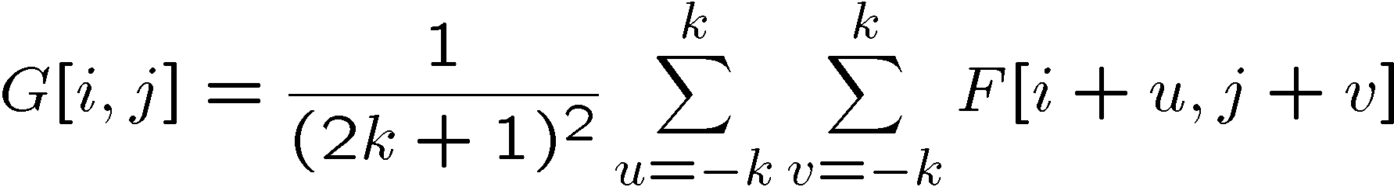
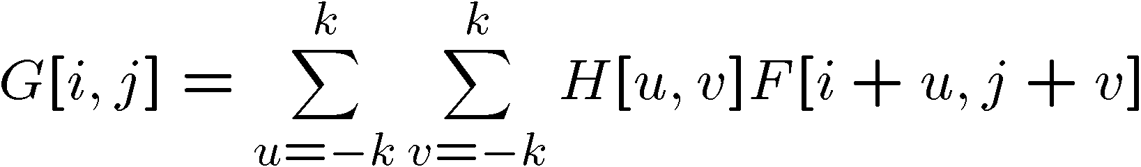
Correlation filtering
Say the averaging window size is 2k+1 x 2k+1:
Attribute uniform weight to each pixel
Loop over all pixels in neighborhood around image pixel F[i,j]
Now generalize to allow different weights depending on neighboring pixel’s relative position:
Non-uniform weights
Kristen Grauman

Slide 36
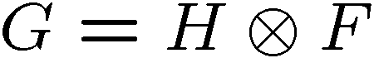
Correlation filtering
This is called cross-correlation, denoted
Filtering an image: replace each pixel with a linear combination of its neighbors.
The filter a.k.a. kernel a.k.a. mask H[u,v] is the prescription for the weights in the linear combination.
Adapted from Kristen Grauman

Slide 37
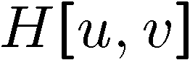

Averaging filter
What values belong in the kernel H for the moving average example?
0 | 0 | 0 | 0 | 0 | 0 | 0 | 0 | 0 | 0
0 | 0 | 0 | 0 | 0 | 0 | 0 | 0 | 0 | 0
0 | 0 | 0 | 90 | 90 | 90 | 90 | 90 | 0 | 0
0 | 0 | 0 | 90 | 90 | 90 | 90 | 90 | 0 | 0
0 | 0 | 0 | 90 | 90 | 90 | 90 | 90 | 0 | 0
0 | 0 | 0 | 90 | 0 | 90 | 90 | 90 | 0 | 0
0 | 0 | 0 | 90 | 90 | 90 | 90 | 90 | 0 | 0
0 | 0 | 0 | 0 | 0 | 0 | 0 | 0 | 0 | 0
0 | 0 | 90 | 0 | 0 | 0 | 0 | 0 | 0 | 0
0 | 0 | 0 | 0 | 0 | 0 | 0 | 0 | 0 | 0
 | 0 | 10 | 20 | 30 | 30
1
1
1
1
?
1
1
1
1
1
“box filter”
Kristen Grauman

Slide 38
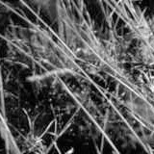
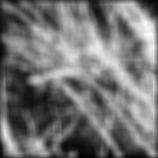
Smoothing by averaging
depicts box filter:
white = high value, black = low value
original
filtered
Kristen Grauman

Slide 39
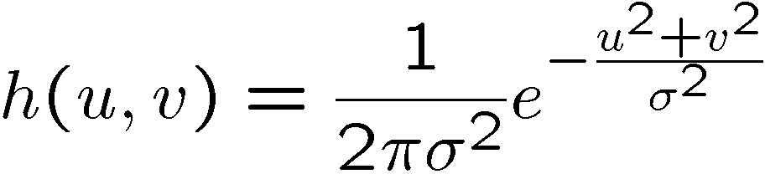


Gaussian filter
What if we want nearest neighboring pixels to have the most influence on the output?
This kernel is an approximation of a 2d Gaussian function:
0 | 0 | 0 | 0 | 0 | 0 | 0 | 0 | 0 | 0
0 | 0 | 0 | 0 | 0 | 0 | 0 | 0 | 0 | 0
0 | 0 | 0 | 90 | 90 | 90 | 90 | 90 | 0 | 0
0 | 0 | 0 | 90 | 90 | 90 | 90 | 90 | 0 | 0
0 | 0 | 0 | 90 | 90 | 90 | 90 | 90 | 0 | 0
0 | 0 | 0 | 90 | 0 | 90 | 90 | 90 | 0 | 0
0 | 0 | 0 | 90 | 90 | 90 | 90 | 90 | 0 | 0
0 | 0 | 0 | 0 | 0 | 0 | 0 | 0 | 0 | 0
0 | 0 | 90 | 0 | 0 | 0 | 0 | 0 | 0 | 0
0 | 0 | 0 | 0 | 0 | 0 | 0 | 0 | 0 | 0
1 | 2 | 1
2 | 4 | 2
1 | 2 | 1
Source: S. Seitz

Slide 40



Convolution
Convolution:
Flip the filter in both dimensions (bottom to top, right to left)
Then apply cross-correlation
h
F
Notation for convolution operator
Kristen Grauman

Slide 41
Convolution vs. correlation
Convolution
Cross-correlation
For a Gaussian or box filter, how will the outputs differ?
Kristen Grauman

Slide 42
Convolution vs. correlation
Cross-correlation
F
5 | 2 | 5 | 4 | 4
5 | 200 | 3 | 200 | 4
1 | 5 | 5 | 4 | 4
5 | 5 | 1 | 1 | 2
200 | 1 | 3 | 5 | 200
1 | 200 | 200 | 200 | 1
(i, j)
u = -1,
v = -1
Convolution
H
.06 | .12 | .06
.12 | .25 | .12
.06 | .12 | .06
(0, 0)

Slide 43
Convolution vs. correlation
Cross-correlation
F
5 | 2 | 5 | 4 | 4
5 | 200 | 3 | 200 | 4
1 | 5 | 5 | 4 | 4
5 | 5 | 1 | 1 | 2
200 | 1 | 3 | 5 | 200
1 | 200 | 200 | 200 | 1
(i, j)
u = -1,
v = -1
v = 0
Convolution
H
.06 | .12 | .06
.12 | .25 | .12
.06 | .12 | .06
(0, 0)

Slide 44
Convolution vs. correlation
Cross-correlation
F
5 | 2 | 5 | 4 | 4
5 | 200 | 3 | 200 | 4
1 | 5 | 5 | 4 | 4
5 | 5 | 1 | 1 | 2
200 | 1 | 3 | 5 | 200
1 | 200 | 200 | 200 | 1
(i, j)
u = -1,
v = -1
v = 0
v = +1
Convolution
H
.06 | .12 | .06
.12 | .25 | .12
.06 | .12 | .06
(0, 0)

Slide 45
Convolution vs. correlation
Cross-correlation
F
5 | 2 | 5 | 4 | 4
5 | 200 | 3 | 200 | 4
1 | 5 | 5 | 4 | 4
5 | 5 | 1 | 1 | 2
200 | 1 | 3 | 5 | 200
1 | 200 | 200 | 200 | 1
(i, j)
u = -1,
v = -1
v = 0
v = +1
u = 0,
v = -1
Convolution
H
.06 | .12 | .06
.12 | .25 | .12
.06 | .12 | .06
(0, 0)

Slide 46
Convolution vs. correlation
Cross-correlation
F
5 | 2 | 5 | 4 | 4
5 | 200 | 3 | 200 | 4
1 | 5 | 5 | 4 | 4
5 | 5 | 1 | 1 | 2
200 | 1 | 3 | 5 | 200
1 | 200 | 200 | 200 | 1
(i, j)
u = -1,
v = -1
Convolution
H
.06 | .12 | .06
.12 | .25 | .12
.06 | .12 | .06
(0, 0)

Slide 47
Convolution vs. correlation
Cross-correlation
F
5 | 2 | 5 | 4 | 4
5 | 200 | 3 | 200 | 4
1 | 5 | 5 | 4 | 4
5 | 5 | 1 | 1 | 2
200 | 1 | 3 | 5 | 200
1 | 200 | 200 | 200 | 1
(i, j)
u = -1,
v = -1
v = 0
Convolution
H
.06 | .12 | .06
.12 | .25 | .12
.06 | .12 | .06
(0, 0)

Slide 48
Convolution vs. correlation
Cross-correlation
F
5 | 2 | 5 | 4 | 4
5 | 200 | 3 | 200 | 4
1 | 5 | 5 | 4 | 4
5 | 5 | 1 | 1 | 2
200 | 1 | 3 | 5 | 200
1 | 200 | 200 | 200 | 1
(i, j)
u = -1,
v = -1
v = 0
v = +1
Convolution
H
.06 | .12 | .06
.12 | .25 | .12
.06 | .12 | .06
(0, 0)

Slide 49
Convolution vs. correlation
Cross-correlation
F
5 | 2 | 5 | 4 | 4
5 | 200 | 3 | 200 | 4
1 | 5 | 5 | 4 | 4
5 | 5 | 1 | 1 | 2
200 | 1 | 3 | 5 | 200
1 | 200 | 200 | 200 | 1
(i, j)
u = -1,
v = -1
v = 0
v = +1
u = 0,
v = -1
Convolution
H
.06 | .12 | .06
.12 | .25 | .12
.06 | .12 | .06
(0, 0)

Slide 50

Predict the outputs using correlation filtering
0
0
0
0
0
0
*
= ?
*
= ?
0
1
0
0
0
1
0
0
0
0
0
0
0
0
0
-
1
1
1
*
= ?
0
2
0
1
1
1
0
0
0
1
1
1
Kristen Grauman

Slide 51
Practice with linear filters
0
0
0
?
0
1
0
0
0
0
Original
Source: D. Lowe

Slide 52
Practice with linear filters
0
0
0
0
1
0
0
0
0
Original
Filtered
(no change)
Source: D. Lowe

Slide 53
Practice with linear filters
0
0
0
?
0
0
1
0
0
0
Original
Source: D. Lowe

Slide 54
Practice with linear filters
0
0
0
0
0
1
0
0
0
Original
Shifted left
by 1 pixel with correlation
Source: D. Lowe

Slide 55
Practice with linear filters
1
1
1
?
1
1
1
1
1
1
Original
Source: D. Lowe

Slide 56

Practice with linear filters
1
1
1
1
1
1
1
1
1
Original
Blur (with a
box filter)
Source: D. Lowe

Slide 57
Practice with linear filters
0
0
0
-
1
1
1
?
0
2
0
1
1
1
0
0
0
1
1
1
Original
Source: D. Lowe

Slide 58

Practice with linear filters
0
0
0
-
1
1
1
0
2
0
1
1
1
0
0
0
1
1
1
Original
Sharpening filter:
accentuates differences with local average
Source: D. Lowe

Slide 59

Sharpening
Kristen Grauman

Slide 60


Filters for computing gradients
1
0
-1
2
0
-2
1
0
-1
*
=
Slide credit: Derek Hoiem

Slide 61

Texture representation: example
 | mean d/dx value | mean d/dy value
Win. #1 | 4 | 10
original image
…
statistics to summarize patterns in small windows
derivative filter responses, squared
Kristen Grauman

Slide 62
Texture representation: example
 | mean d/dx value | mean d/dy value
Win. #1 | 4 | 10
Win.#2 | 18 | 7
original image
…
statistics to summarize patterns in small windows
derivative filter responses, squared
Kristen Grauman

Slide 63
Texture representation: example
 | mean d/dx value | mean d/dy value
Win. #1 | 4 | 10
Win.#2 | 18 | 7
Win.#9 | 20 | 20
original image
…
…
statistics to summarize patterns in small windows
derivative filter responses, squared
Kristen Grauman

Slide 64
Vectors of texture responses
To represent pixel, form a “feature vector” from the responses at that pixel.
To represent image, compute statistics over all pixel feature vectors, e.g. their mean.
[r_{(1,1)}¹, r_{(1,1)}², …, r_{(1,1)}³⁸]
[r_{(1,2)}¹, r_{(1,2)}², …, r_{(1,2)}³⁸]
Pixel location (row, column)
Filter ID
…
[r_{(W,H)}¹, r_{(W,H)}², …, r_{(W,H)}³⁸]
[mean(r_{(:)}¹), mean(r_{(:)}²), …, mean(r_{(:)}³⁸)]

Slide 65






You try: Can you match the texture to the response?
Filters
A
B
1
2
C
3
Mean abs responses
Derek Hoiem

Slide 66

Representing texture by mean abs response
Filters
Mean abs responses
Derek Hoiem

Slide 67
Convolutions: More detail
32x32x3 image
32
height
32
depth
width
3
Andrej Karpathy

Slide 68
Convolutions: More detail
32x32x3 image
5x5x3 filter
32
Convolve the filter with the image
i.e. “slide over the image spatially, computing dot products”
32
3
Andrej Karpathy

Slide 69


Convolution Layer
Convolutions: More detail
32x32x3 image 5x5x3 filter
32
1 number:
the result of taking a dot product between the filter and a small 5x5x3 chunk of the image
(i.e. 5*5*3 = 75-dimensional dot product + bias)
32
3
Andrej Karpathy

Slide 70
Convolution Layer
Convolutions: More detail
activation map
32x32x3 image
5x5x3 filter
32
28
convolve (slide) over all spatial locations
32
28
3
1
Andrej Karpathy

Slide 71
consider a second, green filter
Convolutions: More detail
Convolution Layer
32x32x3 image 5x5x3 filter
activation maps
32
28
convolve (slide) over all spatial locations
32
28
3
1
Andrej Karpathy

Slide 72
For example, if we had 6 5x5 filters, we’ll get 6 separate activation maps:
Convolutions: More detail
activation maps
32
28
Convolution Layer
32
28
3
6
We stack these up to get a “new image” of size 28x28x6!
Andrej Karpathy

Slide 73
Preview: ConvNet is a sequence of Convolution Layers, interspersed with activation functions
Convolutions: More detail
32
28
CONV, ReLU
e.g. 6 5x5x3 filters
32
28
3
6
Andrej Karpathy

Slide 74
Preview: ConvNet is a sequence of Convolutional Layers, interspersed with activation functions
Convolutions: More detail
32
28
24
….
CONV, ReLU
e.g. 6 5x5x3 filters
CONV, ReLU
e.g. 10 5x5x6 filters
CONV, ReLU
32
28
24
3
6
10
Andrej Karpathy

Slide 75

Preview
Convolutions: More detail
[From recent Yann LeCun slides]
Andrej Karpathy

Slide 76

one filter =>
one activation map
Convolutions: More detail
example 5x5 filters
(32 total)
We call the layer convolutional because it is related to convolution of two signals:
Element-wise multiplication and sum of a filter and the signal (image)
Adapted from Andrej Karpathy, Kristen Grauman

Slide 77
A closer look at spatial dimensions:
Convolutions: More detail
activation map
32x32x3 image
5x5x3 filter
32
28
convolve (slide) over all spatial locations
32
28
3
1
Andrej Karpathy

Slide 78
A closer look at spatial dimensions:
Convolutions: More detail
7
7x7 input (spatially) assume 3x3 filter
7
Andrej Karpathy

Slide 79
A closer look at spatial dimensions:
Convolutions: More detail
7
7x7 input (spatially) assume 3x3 filter
7
Andrej Karpathy

Slide 80
A closer look at spatial dimensions:
Convolutions: More detail
7
7x7 input (spatially) assume 3x3 filter
7
Andrej Karpathy

Slide 81
A closer look at spatial dimensions:
Convolutions: More detail
7
7x7 input (spatially) assume 3x3 filter
7
Andrej Karpathy

Slide 82
A closer look at spatial dimensions:
Convolutions: More detail
7
7x7 input (spatially) assume 3x3 filter
=> 5x5 output
7
Andrej Karpathy

Slide 83
A closer look at spatial dimensions:
Convolutions: More detail
7
7x7 input (spatially) assume 3x3 filter applied with stride 2
7
Andrej Karpathy

Slide 84
A closer look at spatial dimensions:
Convolutions: More detail
7
7x7 input (spatially) assume 3x3 filter applied with stride 2
7
Andrej Karpathy

Slide 85
A closer look at spatial dimensions:
Convolutions: More detail
7
7x7 input (spatially) assume 3x3 filter applied with stride 2
=> 3x3 output!
7
Andrej Karpathy

Slide 86
A closer look at spatial dimensions:
Convolutions: More detail
7
7x7 input (spatially) assume 3x3 filter applied with stride 3?
7
Andrej Karpathy

Slide 87
A closer look at spatial dimensions:
Convolutions: More detail
7
7x7 input (spatially) assume 3x3 filter applied with stride 3?
7
doesn’t fit!
cannot apply 3x3 filter on 7x7 input with stride 3.
Andrej Karpathy

Slide 88
Convolutions: More detail
N
Output size:
(N - F) / stride + 1
 |  |  | F
 | F
e.g. N = 7, F = 3:
stride 1 => (7 - 3)/1 + 1 = 5
stride 2 => (7 - 3)/2 + 1 = 3
stride 3 => (7 - 3)/3 + 1 = 2.33 :\
N
Andrej Karpathy

Slide 89
In practice: Common to zero pad the border
Convolutions: More detail
0 | 0 | 0 | 0 | 0 | 0
0
0
0
0
e.g. input 7x7
3x3 filter, applied with stride 1
pad with 1 pixel border => what is the output?
(recall:)
(N - F) / stride + 1
Andrej Karpathy

Slide 90
In practice: Common to zero pad the border
Convolutions: More detail
0 | 0 | 0 | 0 | 0 | 0
0
0
0
0
e.g. input 7x7
3x3 filter, applied with stride 1
pad with 1 pixel border => what is the output?
7x7 output!
Andrej Karpathy

Slide 91
In practice: Common to zero pad the border
Convolutions: More detail
0 | 0 | 0 | 0 | 0 | 0
0
0
0
0
e.g. input 7x7
3x3 filter, applied with stride 1
pad with 1 pixel border => what is the output?
7x7 output!
in general, common to see CONV layers with stride 1, filters of size FxF, and zero-padding with (F-1)/2. (will preserve size spatially)
e.g. F = 3 => zero pad with 1 F = 5 => zero pad with 2 F = 7 => zero pad with 3
(N + 2*padding - F) / stride + 1
Andrej Karpathy

Slide 92

Goodfellow DL book

Slide 93
Convolutions: More detail
Examples time:
Input volume: 32x32x3
10 5x5x3 filters with stride 1, pad 2
Output volume size: ?
Andrej Karpathy

Slide 94
Convolutions: More detail
Examples time:
Input volume: 32x32x3
10 5x5x3 filters with stride 1, pad 2
Output volume size:
(32+2*2-5)/1+1 = 32 spatially, so
32x32x10
Andrej Karpathy

Slide 95
Convolutions: More detail
Examples time:
Input volume: 32x32x3
10 5x5x3 filters with stride 1, pad 2
Number of parameters in this layer?
Andrej Karpathy

Slide 96
Examples time:
Convolutions: More detail
Input volume: 32x32x3
10 5x5x3 filters with stride 1, pad 2
Number of parameters in this layer? each filter has 5*5*3 + 1 = 76 params
=> 76*10 = 760
(+1 for bias)
Andrej Karpathy

Slide 97

Putting it all together
Andrej Karpathy

